Slide 1
SPRING MVC 4 with TILES 3 SPRING DATA JPA
Instructor:

Slide 2
Table Content
1
Spring MVC 4 and Tiles 3
2
Spring Data JPA

Slide 3
Learning Goals
After the course, attendees will be able to:
Understand Spring 4 MVC Framework with Tiles 3 and Spring Data JPA.
Know how to write a Web application using Spring Data JPA.

Slide 4
Tiles 3
Section 1

Slide 5
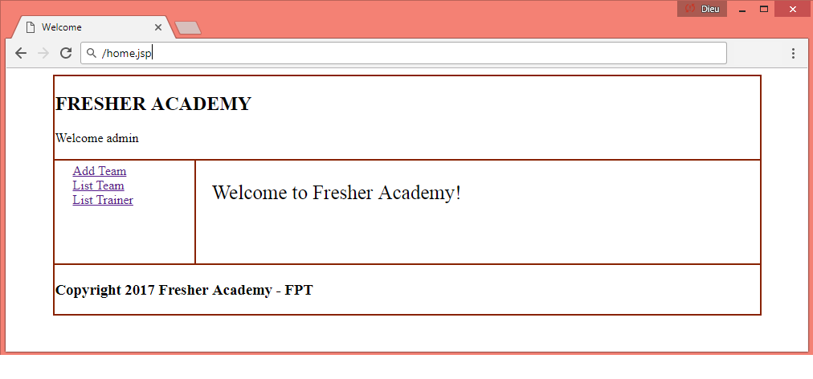

Introduction to Spring MVC
Spring provides integration support with apache tiles framework. So we can simply manage the layout of the spring mvc application by the help of spring tiles support.
Notes:
Spring Framework ra xuất phát từ sự thành công của EJB (Enterprise JavaBean)- một kiến trúc phát triển dành cho các ứng dụng doanh nghiệp có tính mở rộng cao;
Phát triển năm 2002 bởi Rod Johnson. J2EE Development without EJB
Theo một số nguồn, trên 50% các ứng dụng web Java hiện nay đang sử dụng Spring.
Đơn giản hóa công việc phát triển thông qua việc sử dụng các đối tượng Java đơn giản hay còn được gọi là POJO (Plain Old Java Object)
Sử dụng DI và interface;
Sử dụng convention và aspect (quy tắc chung);
One of the chief advantages of the Spring framework is its layered architecture.
You can be selective about which of its components you use while also providing a cohesive framework for J2EE application development

Slide 6
Advantage of Tiles support in Spring MVC
Reusability
Centralized control
We can reuse a single component in multiple pages like header and footer components.
We can control the layout of the page by a single template page only.
Easy to change the layout
By the help of single template page, we can change the layout of the page anytime. So your website can easily adapt new technologies such as bootstrap, jquery etc.

Slide 7
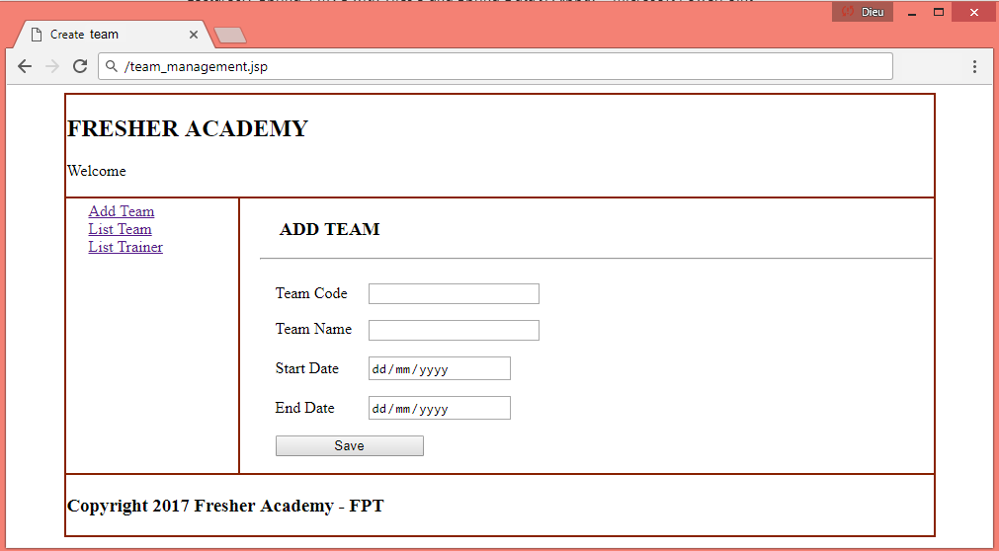
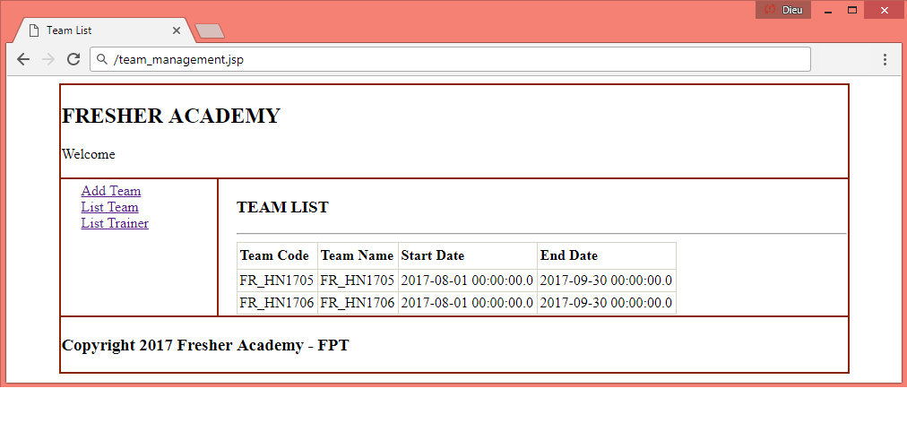
Spring MVC Tiles Example

Slide 8
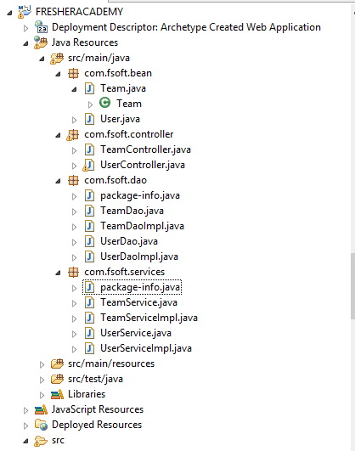
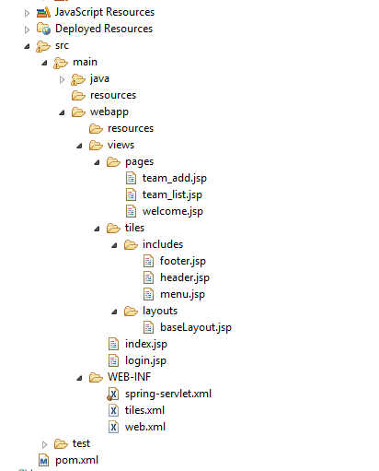
Directory structure

Slide 9
(1) Required Maven Dependency
Add maven dependency in pom.xml file.
<project ...>
<!-- ....-->
<properties>
<project.build.sourceEncoding>UTF-8
</project.build.sourceEncoding>
<spring.version>4.3.2.RELEASE</spring.version>
<junit.version>4.12</junit.version>
<servlet.version>3.1.0</servlet.version>
<apachetiles.version>3.0.5</apachetiles.version>
</properties>
<dependencies>
<!-- Junit -->
<dependency>
<groupId>junit</groupId>
<artifactId>junit</artifactId>
<version>${junit.version}</version>
<scope>test</scope>
</dependency>
<!--Servlet-Api -->
<dependency>
<groupId>javax.servlet</groupId>
<artifactId>javax.servlet-api</artifactId>
<version>${servlet.version}</version>
</dependency>
<!-- Spring Framework -->
<dependency>
<groupId>org.springframework</groupId>
<artifactId>spring-core</artifactId>
<version>${spring.version}</version>
</dependency>
<dependency>
<groupId>org.springframework</groupId>
<artifactId>spring-beans</artifactId>
<version>${spring.version}</version>
</dependency>
<dependency>
<groupId>org.springframework</groupId>
<artifactId>spring-context</artifactId>
<version>${spring.version}</version>
</dependency>
<dependency>
<groupId>org.springframework</groupId>
<artifactId>spring-webmvc</artifactId>
<version>${spring.version}</version>
</dependency>

Slide 10
(1) Required Maven Dependency
Add maven dependency in pom.xml file.
<!-- Spring JDBC -->
<dependency>
<groupId>org.springframework</groupId>
<artifactId>spring-jdbc</artifactId>
<version>${spring.version}</version>
</dependency>
<!-- JSTL -->
<dependency>
<groupId>javax.servlet</groupId>
<artifactId>jstl</artifactId>
<version>1.2</version>
</dependency>
<!-- MS SQL Server -->
<dependency>
<groupId>com.microsoft.sqlserver</groupId>
<artifactId>mssql-jdbc</artifactId>
<version>6.1.0.jre7</version>
</dependency>
<!-- Apache Tiles -->
<dependency>
<groupId>org.apache.tiles</groupId>
<artifactId>tiles-core</artifactId>
<version>${apachetiles.version}</version>
</dependency>
<dependency>
<groupId>org.apache.tiles</groupId>
<artifactId>tiles-api</artifactId>
<version>${apachetiles.version}</version>
</dependency>
<dependency>
<groupId>org.apache.tiles</groupId>
<artifactId>tiles-servlet</artifactId>
<version>${apachetiles.version}</version>
</dependency>
<dependency>
<groupId>org.apache.tiles</groupId>
<artifactId>tiles-jsp</artifactId>
<version>${apachetiles.version}</version>
</dependency>

Slide 11
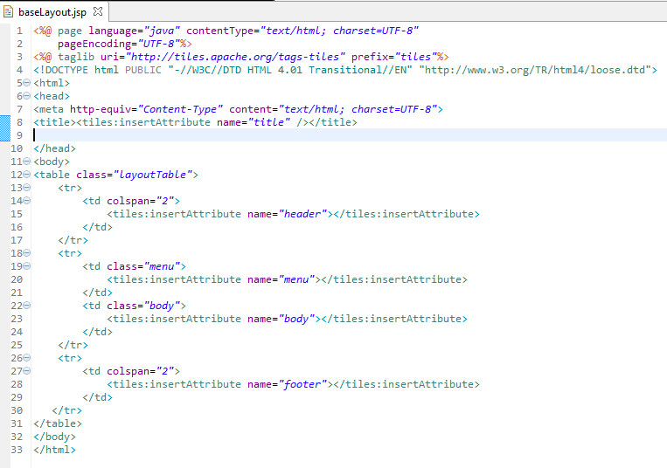
(2) View Components
/webapp/views/tiles/layouts/baseLayout.jsp

Slide 12
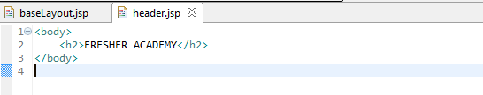
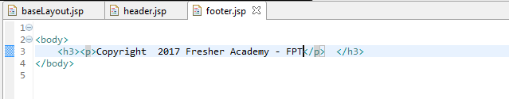
(2) View Components
/webapp/views/tiles/includes/header.jsp
/webapp/views/tiles/includes/footer.jsp

Slide 13
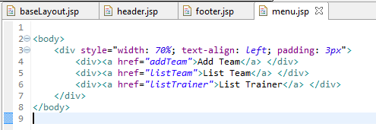

(2) View Components
/webapp/views/tiles/includes/menu.jsp
/webapp/views/pages/welcome.jsp

Slide 14
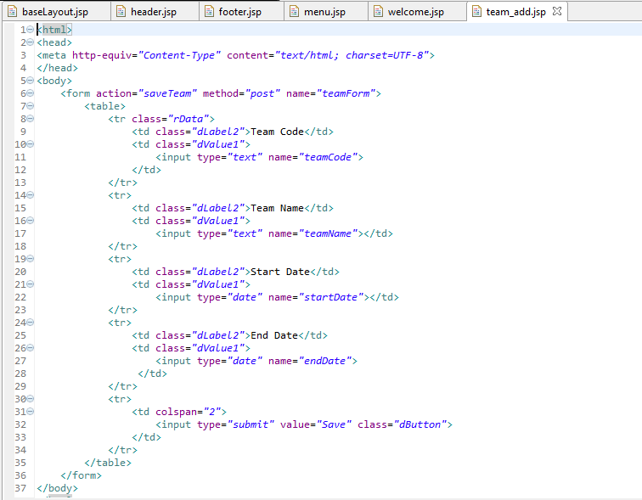
(2) View Components

Slide 15
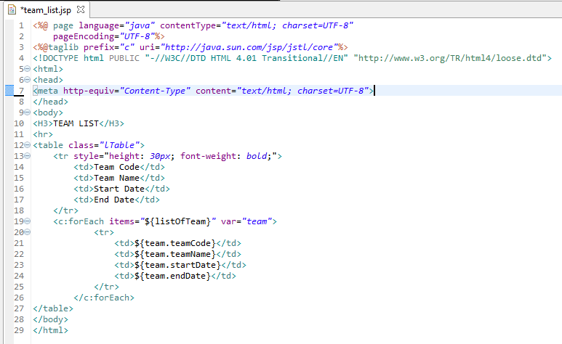
(2) View Components

Slide 16
(3) Bean classes
Create Team class
public class Team {
private String teamCode;
private String teamName;
private Date endDate;
private Date startDate;
public Team() {
}
/*
* getter, setter methods
*/
}

Slide 17
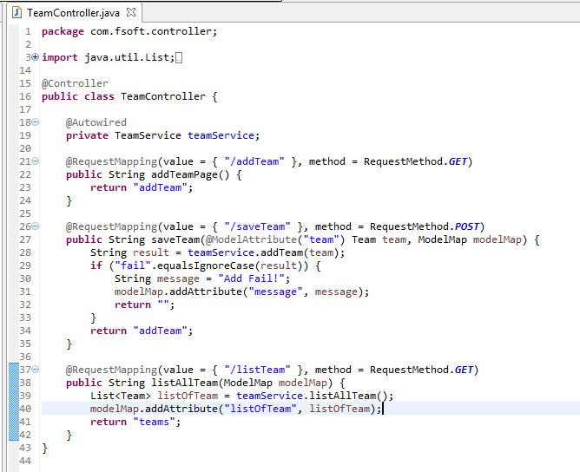
(3) Controller classes

Slide 18
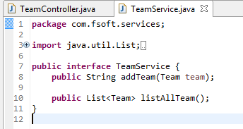
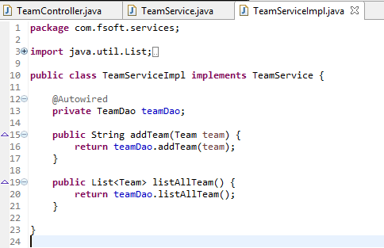
(3) Service classes

Slide 19
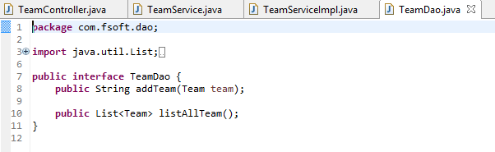
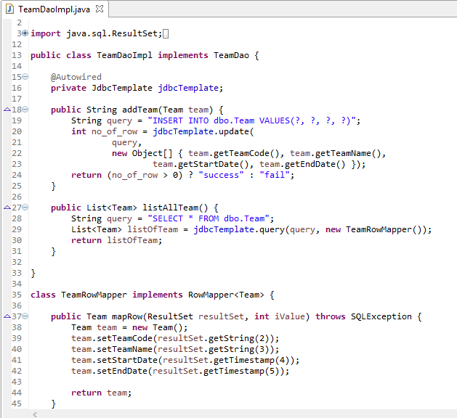
(3) DAO classes

Slide 20
(4) Define the bean in the xml file
This is the important configuration file where we need to specify the ViewResolver and View components.
<bean id="teamDao" class="com.fsoft.dao.TeamDaoImpl" />
<bean id="teamService" class="com.fsoft.services.TeamServiceImpl" />
<!– View resolver-->
<bean id="viewResolver“ class="org.springframework.web.servlet.view.tiles3.TilesViewResolver">
<property name="viewClass" >
<value>org.springframework.web.servlet.view.tiles3.TilesView</value>
</property>
</bean>
<!-- Tiles configuration -->
<bean id="tilesConfigurer"
class="org.springframework.web.servlet.view.tiles3.TilesConfigurer">
<property name="definitions">
<list>
<value>/WEB-INF/tiles.xml</value>
</list>
</property>
</bean>

Slide 21
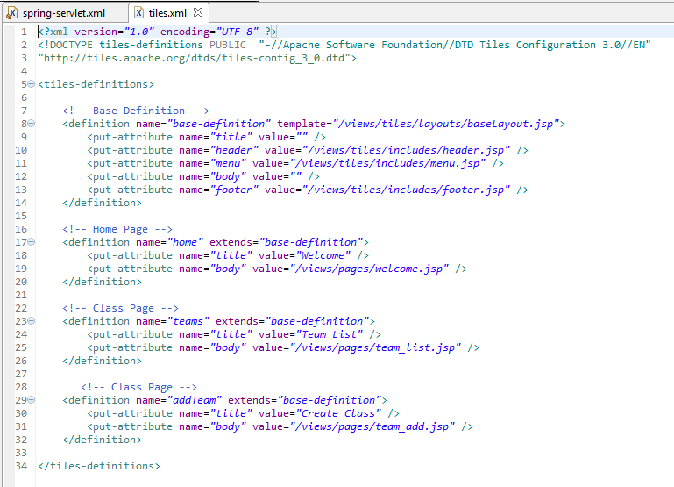
(5) tiles.xml
/WEB-INF/tiles.xml

Slide 22
Spring Data jpa
Section 2

Slide 23
Introduction
Spring Data JPA (Java Persistance API)
The goal of Spring Data repository abstraction is to significantly reduce the amount of boilerplate code required to implement data access layers for various persistence stores.
The central interface in Spring Data repository abstraction is Repository.
It takes the domain class to manage as well as the id type of the domain class as type arguments.
This interface acts primarily as a marker interface to capture the types to work with and to help you to discover interfaces that extend this one.

Slide 24
Define a Spring Data repository
The next step is to define a repository, which we can do by implementing one of the following Spring Data Repository interfaces:
Repository
The base interface that all repositories must extend.
CrudRepository
It does not provide any generated method implementations. You are able to define methods like findByName() and findByCityAndState().
Extends Repository and comes complete with CRUD functionality.
By extending this interface you'll automatically pick up methods like findOne(ID), findAll(), save(), delete(), and deleteAll() and Spring Data will generate implementations of each method for you.
PagingAndSortingRepository
Extends the CrudRepository and adds support for paging and sorting results.
If you have a lot of results in your query, you can create a Pageable instance that defines a page size and a page number and Spring Data will retrieve that specific page from the data store. Additionally, Spring Data defines a Sort class that can be used to order the data from the query.

Slide 25
CrudRepository interface
public interface CrudRepository<T, ID extends Serializable> extends Repository<T, ID> {
<S extends T> S save(S entity); // (1)
T findOne(ID primaryKey); // (2)
Iterable<T> findAll(); // (3)
Long count(); // (4)
void delete(T entity); // (5)
boolean exists(ID primaryKey); // (6)
// … more functionality omitted.
}
Method | Explain
(1) | Saves the given entity.
(2) | Returns the entity identified by the given id.
(3) | Returns all entities.
(4) | Returns the number of entities.
(5) | Deletes the given entity.
(6) | Indicates whether an entity with the given id exists.

Slide 26
CrudRepository interface
In addition to query methods, query derivation for both count and delete queries, is available.
Example 1: Derived Count Query
public interface TrainerRepository extends CrudRepository<Trainer, Long> {
Long countByTrainerName(String trainerName);
}
Example 2: Derived Delete Query
public interface TrainerRepository extends CrudRepository<Trainer, Long> {
Long deleteByTrainerName(String trainerName);
List<Trainer> removeByTrainerName(String trainerName);
}

Slide 27
PagingAndSortingRepository interface
On top of the CrudRepository there is a PagingAndSortingRepository abstraction that adds additional methods to ease paginated access to entities:
PagingAndSortingRepository<T,ID methods:
public interface PagingAndSortingRepository<T, ID extends Serializable> extends CrudRepository<T, ID> {
Iterable<T> findAll(Sort sort);
Page<T> findAll(Pageable pageable);
}
Accessing the second page of Team by a page size of 20 you could simply do something like this:
PagingAndSortingRepository<Team, Long> repository = // … get access to a bean
Page<Team> teams = repository.findAll(new PageRequest(1, 20));

Slide 28
Query methods
The JPA module supports defining a query manually as String or have it being derived from the method name.
Can either use JPA named queries through a naming convention: @NamedQueries.
Or Rather annotate your query method with: @Query.
Assume that we have following table:
CREATE TABLE Trainer(
trainer_id INT IDENTITY(1,1) PRIMARY KEY,
trainer_account VARCHAR(50) NOT NULL UNIQUE,
trainer_name NVARCHAR(100),
trainer_email NVARCHAR(100),
mobile_phone VARCHAR(20),
)

Slide 29
Query methods
Create Trainer class in com.fsoft.entities package:
@Entity
@NamedQuery(name="Trainer.findAll", query="SELECT t FROM Trainer t")
public class Trainer implements Serializable {
private static final long serialVersionUID = 1L;
@Id
@Column(name="trainer_id")
private int trainerId;
@Column(name="mobile_phone")
private String mobilePhone;
@Column(name="trainer_account")
private String trainerAccount;
@Column(name="trainer_email")
private String trainerEmail;
@Column(name="trainer_name")
private String trainerName;
public Trainer() {
}
// getter-setter methods

Slide 30
Query methods: @Query
Generally the query creation mechanism for JPA works as described in Query methods. Here’s a short example of what a JPA query method translates into:
Example 1: Declare query at the query method using @Query
public interface TrainerRepository extends JpaRepository<Trainer, Long> {
@Query(“SELECT t FROM dbo.Trainer t WHERE t.trainer_name = ?1")
Trainer findByTrainerName(String trainerName);
}
Example 2: Using advanced LIKE expressions
public interface TrainerRepository extends JpaRepository<Trainer, Long> {
@Query(“SELECT t FROM dbo.Trainer t WHERE t.trainer_name LIKE %?1")
Trainer findByTrainerName(String trainerName);
}

Slide 31
Query methods: @Query
Example 3: Declare native count queries for pagination at the query method using @Query
public interface TrainerRepository extends JpaRepository<Trainer, Long> {
@Query(value = "SELECT * FROM TRAINER WHERE trainer_name = ?1",
countQuery = "SELECT count(*) FROM Trainer WHERE trainer_name= ?1",
nativeQuery = true)
Page<Team> findByTrainername(String trainerName, Pageable pageable);
}
Example 4: Using named parameters
public interface TrainerRepository extends JpaRepository<Trainer, Long> {
@Query(“SELECT t FROM Trainer t WHERE t.trainer_name= :trainerName)
Trainer findByLastnameOrFirstname(@Param(“trainerName ") String trainerName);
}

Slide 32
Query methods: @NamedQueries
Annotation based named query configuration:
@Entity
@NamedQuery(
name = “Trainer.findByTrainerName",
query = “SELECT T FROM Trainer t WHERE t.trainerName = ?1")
public class Trainer{
}

Slide 33
Stored procedures
The JPA 2.1 specification introduced support for calling stored procedures via the JPA criteria query API.
We Introduced the @Procedure annotation for declaring stored procedure metadata on a repository method.
Example: the definition of the usp_count_trainer procedure in SQL Server:
CREATE PROCEDURE dbo.usp_acount_trainer(
@trainerName NVARCHAR(100),
@amount INT OUTPUT)
AS
BEGIN
SELECT @amount = COUNT(*) FROM dbo.Trainer
WHERE trainer_name = @trainerName;
END

Slide 34
Stored procedures
Metadata for stored procedures can be configured via the NamedStoredProcedureQuery annotation on an entity type.
Update Team class:
@Entity
@NamedStoredProcedureQuery(name = “Trainer. findByTrainerName",
procedureName = “usp_count_trainer",
parameters = {
@StoredProcedureParameter(mode = ParameterMode.IN,
name = “trainerName", type = String.class),
@StoredProcedureParameter(mode = ParameterMode.OUT,
name = “amount", type = Integer.class) })
public class Trainer{
}

Slide 35
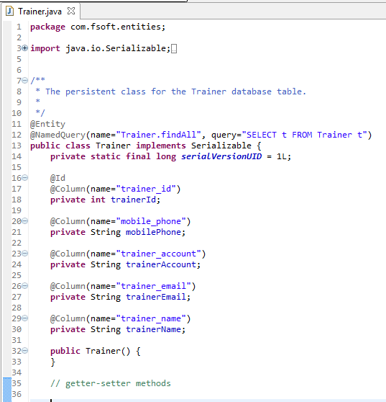
CrudRepository example
Use the project in the Tiles example.
(1) Create entity classes:

Slide 36
(2) pom.xml
Dependency Addition :
<properties>
//..
<hibernate.version>4.3.10.Final</hibernate.version>
</properties>
<!-- Hibernate -->
//..
<dependency>
<groupId>org.hibernate</groupId>
<artifactId>hibernate-core</artifactId>
<version>${hibernate.version}</version>
</dependency>
<dependency>
<groupId>org.hibernate</groupId>
<artifactId>hibernate-entitymanager</artifactId>
<version>${hibernate.version}</version>
</dependency>
<dependency>
<groupId>org.hibernate.javax.persistence</groupId>
<artifactId>hibernate-jpa-2.1-api</artifactId>
<version>1.0.0.Final</version>
</dependency>

Slide 37
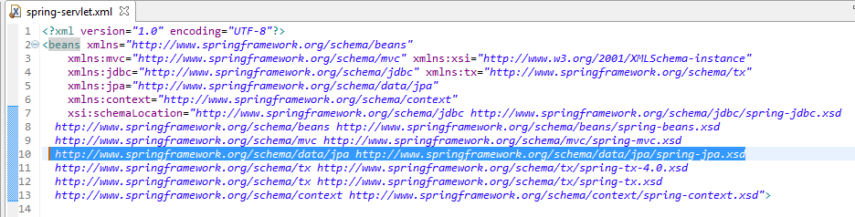
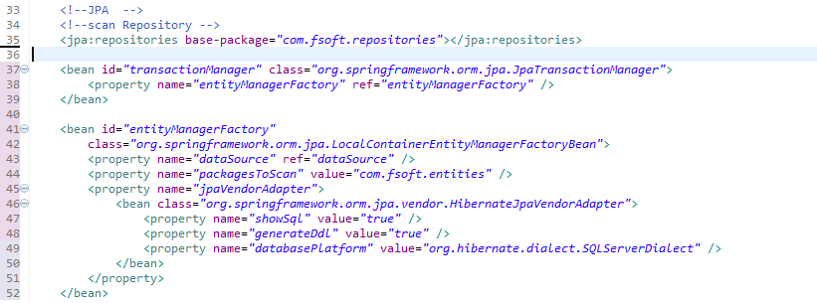
(3) Define the bean in the xml file
Notes:
<?xml version="1.0" encoding="UTF-8"?>
<beans xmlns="http://www.springframework.org/schema/beans"
xmlns:mvc="http://www.springframework.org/schema/mvc" xmlns:xsi="http://www.w3.org/2001/XMLSchema-instance"
xmlns:jdbc="http://www.springframework.org/schema/jdbc" xmlns:tx="http://www.springframework.org/schema/tx"
xmlns:jpa="http://www.springframework.org/schema/data/jpa"
xmlns:context="http://www.springframework.org/schema/context"
xsi:schemaLocation="http://www.springframework.org/schema/jdbc http://www.springframework.org/schema/jdbc/spring-jdbc.xsd
http://www.springframework.org/schema/beans http://www.springframework.org/schema/beans/spring-beans.xsd
http://www.springframework.org/schema/mvc http://www.springframework.org/schema/mvc/spring-mvc.xsd
http://www.springframework.org/schema/data/jpa http://www.springframework.org/schema/data/jpa/spring-jpa.xsd
http://www.springframework.org/schema/tx http://www.springframework.org/schema/tx/spring-tx-4.0.xsd
http://www.springframework.org/schema/tx http://www.springframework.org/schema/tx/spring-tx.xsd
http://www.springframework.org/schema/context http://www.springframework.org/schema/context/spring-context.xsd">
<jpa:repositories base-package="com.fsoft.repositories"></jpa:repositories>
<bean id="transactionManager" class="org.springframework.orm.jpa.JpaTransactionManager">
<property name="entityManagerFactory" ref="entityManagerFactory" />
</bean>
<bean id="entityManagerFactory"
class="org.springframework.orm.jpa.LocalContainerEntityManagerFactoryBean">
<property name="dataSource" ref="dataSource" />
<property name="packagesToScan" value="com.fsoft.entities" />
<property name="jpaVendorAdapter">
<bean class="org.springframework.orm.jpa.vendor.HibernateJpaVendorAdapter">
<property name="showSql" value="true" />
<property name="generateDdl" value="true" />
<property name="databasePlatform" value="org.hibernate.dialect.H2Dialect" />
</bean>
</property>
</bean>

Slide 38
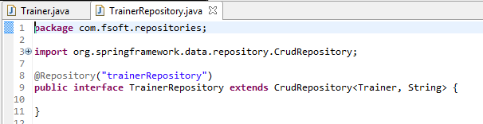
(4) Create repository
Create TrainerRepositoty interface in com.fsoft.repositories package:

Slide 39
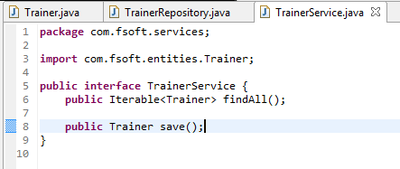
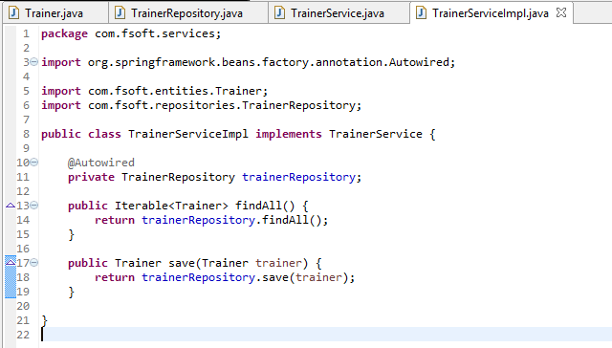
(4) Update service classses

Slide 40
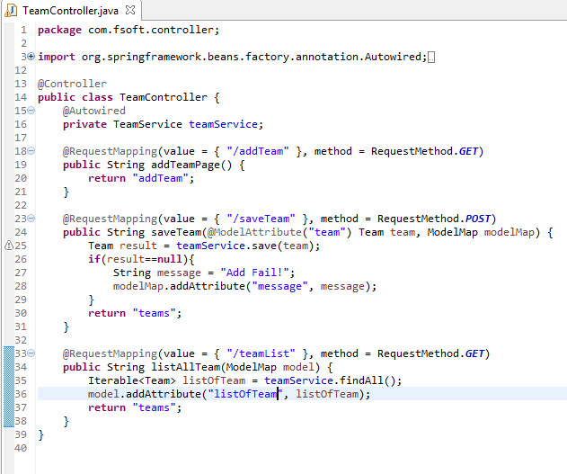
(5) Controller classes

Slide 41
SUMMAY
1
Spring MVC 4 and Tiles 3
2
Spring Data JPA

Slide 42

Thank you
42

